Slide 1
BRITISH AIRWAYS
WEB SCRAPING TO GAIN COMPANY INSIGHTS

Slide 2
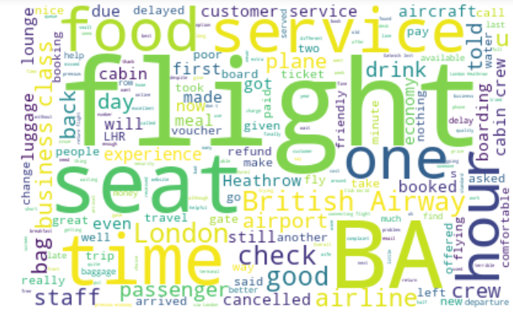
NO OF POSITIVE REVIEWS =229
NO OF NEGATIVE REVIEWS =76
NO OF NEUTRAL REVIEWS =695
Common words found in reviews

